Slide 1
Title: FOOD DELIVERY APP
Team - C08
Team Members:
1.Mahathi V (20BCE1903)
2.Kovvuri Chandra Kiran Reddy (20BCE1936)
3.Naveen Narayan (20BCE1989)
4.Tulasi Vamsi Krishna (20BEC1110)
Affiliation Date: 19/06/2023

Slide 2
Introduction
The innovative food delivery platform that brings a world of culinary delights right to your doorstep.
With our user-friendly app, you can explore a vast selection of restaurants and cuisines, browse enticing menus, and place your order with ease.
Whether you're craving a hearty burger, authentic ethnic dishes, or a refreshing salad, we've got you covered. Our reliable app services makes your dining experience hassle free.
In the upcoming slides, we will be addressing the challenges faced by current food delivery websites and presenting our approach to tackle these issues. Additionally, we will highlight the relevant work we have done to address these problems effectively.

Slide 3
Problem Statement
Food delivery apps are a pathway in connecting people more with the restaurants in their locality.
This connection becomes weak when the wesite is restricted with a static menu database.
The restaurants has to be treated equally.
Customers has to be provided more ways to find the right dish with ease.
Customer and restaurants data privacy has to be respected and protected.

Slide 4
Methodology/Approach
Providing Customers and Restaurants ways to create their own menu sections based on their interests.
Restaurants are ordered from top to bottom in the customer menu section on a first-come, first-served basis.
Technologies used:
React Js - Used in the frontend part of the app.
Node Js & Express Js- Used in the backend part of the app.
MongoDB - Used for the database for the app.
Email Js - Used to send emails and from node.js to any smtp server.
Material UI - Used to get advanced UI component framework.
Bcrypt Js - Used to hash the password entered by the user and store It in the database protecting their privacy.

Slide 5
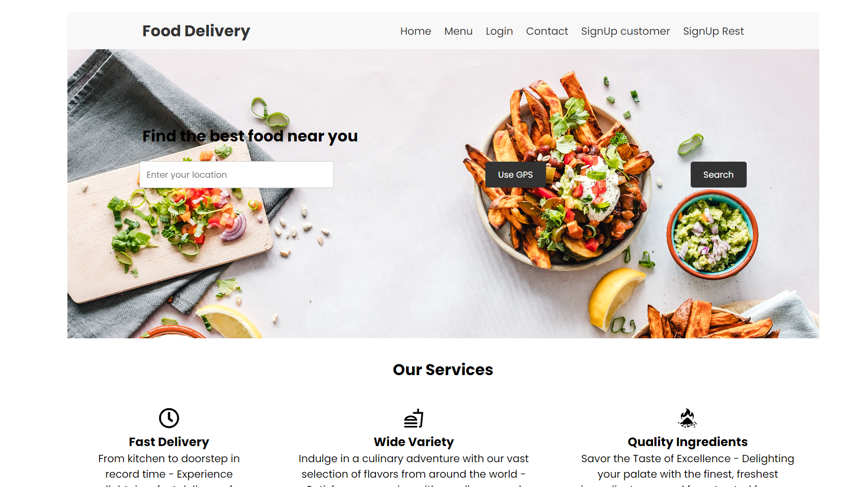
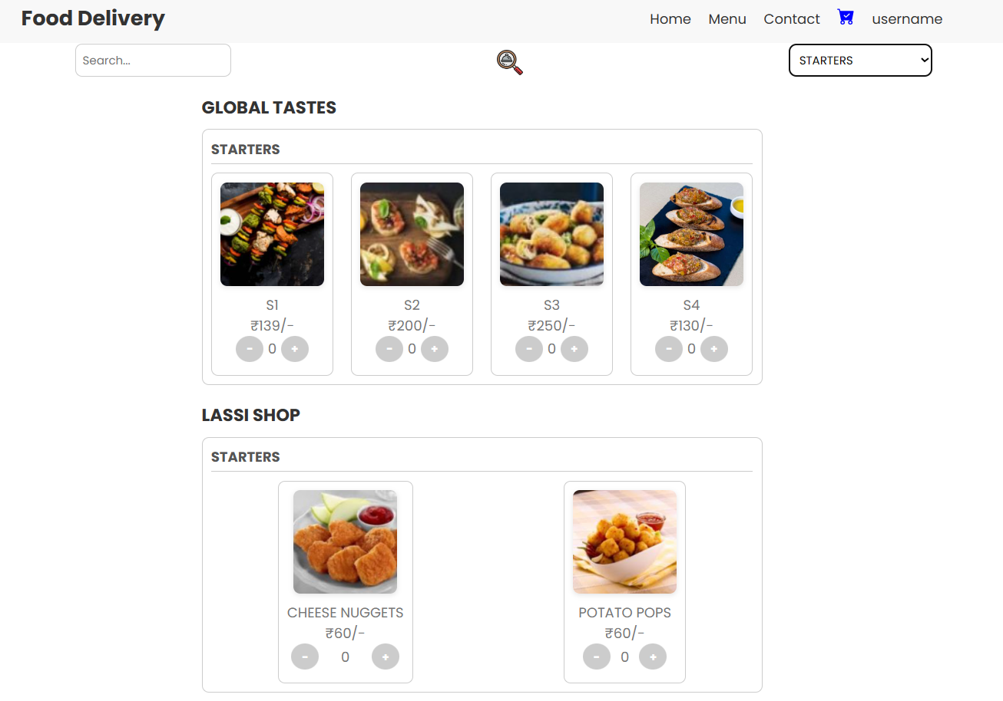
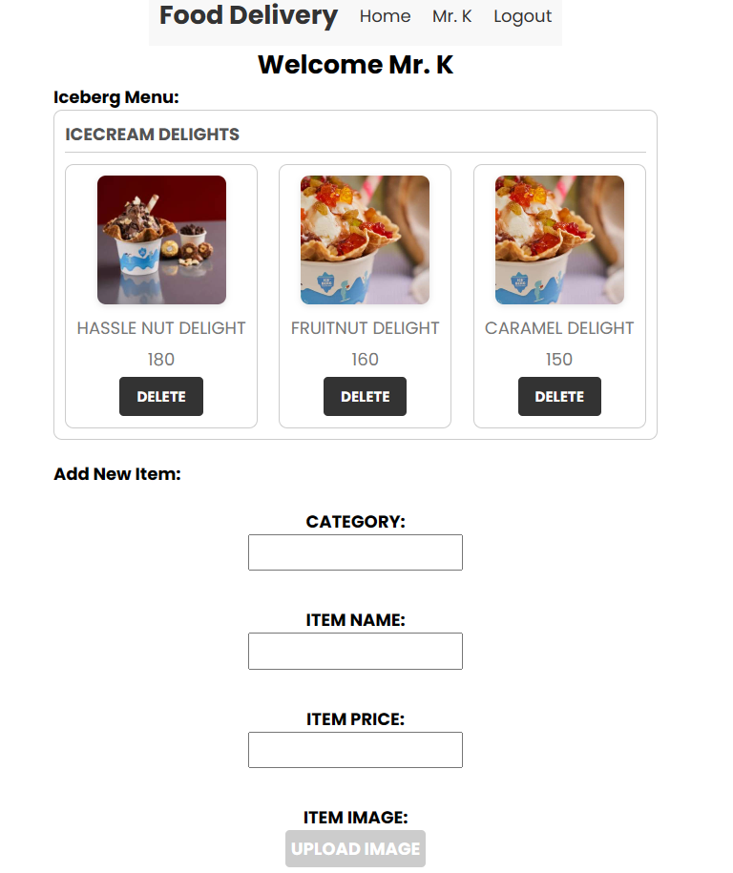
Result and Analysis

Slide 6
Discussion & Conclusion
The food delivery platform is integrated with razorpay gateway for secure payments.
The food delivery platform helps customers and restaurants to make their own customised menu.
Thus we conclude that our food delivery platform provides a hassle-free experience for both customers and restaurants.
The food delivery platform currently lacks essential features such as an orders section and order tracking for customers. As part of our plans, we aim to develop and integrate these features with the platform's backend.

Slide 7
Acknowledgment
We would like to express our sincere appreciation to the Ethnus team for their unwavering support and guidance throughout our MERN stack course journey. Their expertise, dedication, and commitment to our learning experience have been invaluable. We are grateful for their continuous assistance, which has helped us successfully navigate and master the intricacies of the MERN stack. Thank you, Ethnus team, for your exceptional support and contributions to our growth and development.

Slide 8
THANK YOU

